Slide 1
WEEK 1
Python in Hacking

Slide 2
This week…
Introduction
RegEx

Slide 3
Who is a Hacker?

Slide 5
Hacking?

Slide 6
Reasons for attacks
Installing Malware
Stealing Data
Disrupting Service
Political
Profits
Prove they can :/
more

Slide 7
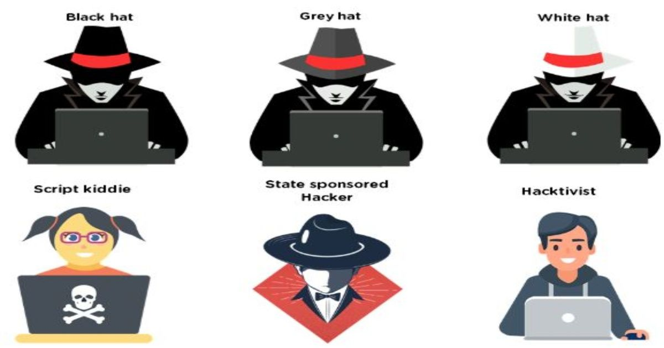
Notes:
https://www.globalsign.com/en/blog/cyber-autopsy-series-phishing-attack-magellan-health#:~:text=In%20April%20of%202020%2C%20Magellan,ransomware%20attack%20on%20the%20provider.
https://www.thesslstore.com/blog/mysterious-russian-grey-hat-vigilante-patched-over-100000-routers/

Slide 8
How?

Slide 9
Reconnaissance
Scanning
Gaining Access
Maintaining Access
Clearing Tracks

Slide 10
Reconnaissance
Gathering information about the target
Active and Passive
Passive – Access anything publicly available.
Active – Instigate a process to get information, like scanning the target network.
Tools conventionally used
Wireshark
Nmap
Burpsuite

Slide 11
Scanning
Scan the target for vulnerabilities
Vulnerabilities could be open ports, outdated software, insecure apps, etc.
Tools used
Nmap
Aircrack-NG
SQLmap

Slide 12

Gaining Access
Break into the target network/system and get full access
Involves
gaining access to the system
Privilege Escalation

Slide 13

Maintaining Access
Create backdoors
Plant malware
Basically, maintain the access you’ve just fought so hard to get.

Slide 14

Clearing Tracks
Clear ALL evidence
Delete logs
Make sure the attack can’t be traced back to you

Slide 15
RegEx

Slide 16
What’s an FSM?

